Slide 1
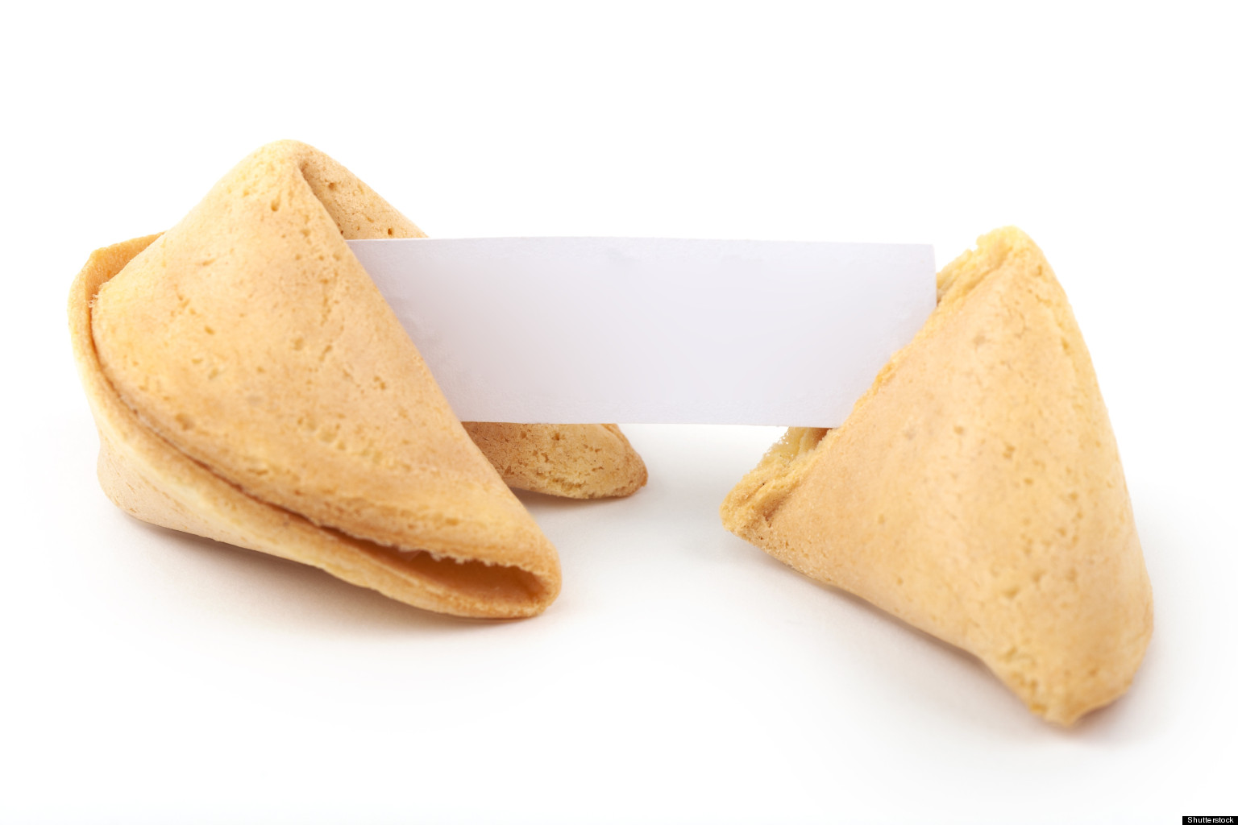
FORTUNE COOKIE DIRECTIONS:
Start with the slide number you are assigned.
Have someone read the question.
The person who reads starts by sharing one idea out loud, then other team members take turns one person at a time.
Have your recorder/reporter take notes for your group.
(SUGGESTION: Use a different color for each group.)
WAIT until you are told to switch.
Go on to the next slide and have someone different read the question and start sharing their idea.
Repeat until done.

Slide 2
How do you effectively manage teams? (build, sustain, choose, manage)
.MAP scores
Ability levels for one activity or one day.
Behavioral grouping
Re-enforce roles early and often
Self-evaluation of team members
Teambuilding at the beginning of each chapter, getting to know you, brainteasers, set a team goal, share pet peeves and strengths
Build based on personalities, MAP and test scores, (random assignment was less effective)
Try to get them to self-manage if they have a strong facilitator
Rewarded students with extra responsibilities in classroom

Slide 3
How do you get students to ask each other questions? How do you answer questions?
Participation quizzes
As a teacher, refuse to answer, so they ask each other
Practice and Modeling
Facilitation of students asking each other questions
Answering questions with guiding questions
Pocket Questions
“I Spy”
Answer with a question
Poster of question starters
Question starters taped onto desk
I answer with a question, or reference a resource in the room or in the textbook/toolkit

Slide 4
How do you deal with homework? (grading, correcting, motivating, late work)
Grade for completion and check for accuracy
Students tally what problems they have questions on so teacher knows what to go over
Answer key on the table so students can check their own work
Fun Friday’s- no missing work
Paying for competition
Students send home weekly email with current grades and missing work
Tricking students into doing it
Points for completion
Adapting for specific students
Solutions on board, take questions for those who are unsure
Catch-up club to complete
Participation/completion grades
Trade & Grade
Put homework onto worksheets, if students don’t turn it in, they call home
If the class reaches ___% completion for the week, no weekend homework.

Slide 5
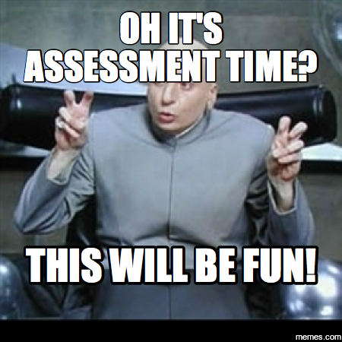
What have you done for assessments? (formative, summative, likes, dislikes)
Team and Partner Quzzes
Formative after every 4 to 5 lessons
Summative must include fluency and explanation
LOVE test reflections!
IDEA: write feedback on student test, have students read feedback, make corrections, and reflect before they can receive their grade
Tests and quizzes
Exit slips
Individual and team tests
Questioning teams and/or individual students
Group quizzes (sometimes helps review for individual tests)
Highlight mistakes, no grade
Give written feedback
I like that you …
An area you can grow...

Slide 6
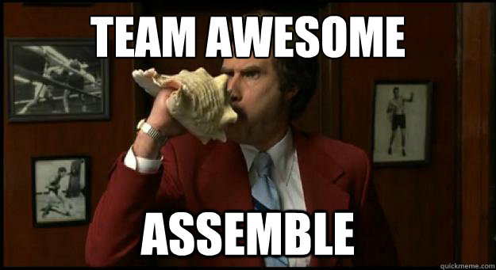
What is working and/or not working for rules and team norms?
Too often students want to work independently
Difficulty in getting all students to take responsibility for their own learning
Team Tips -- numbered “norms” to help refer to during class discussions
“Academic” level do not want to work together
Working: When groups have to work on poster paper for the class period or on whiteboards instead of in notebooks
Students don’t like to collaborate and discuss--work on their own and state their answers w/ little discussion
Team DOJO points
Students refusing to work (either they know it or they are super lost)
Not training kids into their role
Review team norms and periodic checks

Slide 7
What structures and organization have helped you and your students?
Team Tips -- numbered “norms” to help refer to during class discussions
Charting Progress
Routines of materials needed and when they should be out, warm-up problem while teacher checks homework, HW & lesson topic posted on board
Materials bins on tables
Calculators assigned
Daily routine:
Agenda on board with objectives, lesson number, homework
Remind text messaging
Weekly email home to parents/students with help videos, questions to ask student, classwork/homework

Slide 8
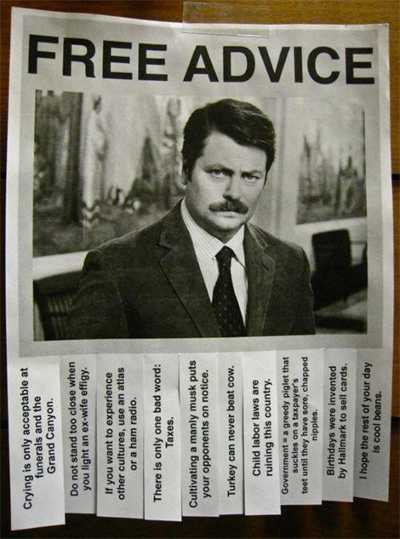
What advice do you want to pass on or remember for next year?
Make sure we are using enough formative assessments
Use more STTS
Re-inforce the team roles more often
Different assessment methods
More explicit modeling of team roles
Have students do more reflection on their solutions and mistakes (i.e. “favorite mistakes test”)
Plan to use technology and google classroom at least once per week

Slide 9
What can we do to help ALL students grow their mathematical understanding, perseverance, and attitudes about math?
Focus on process, not answer
Positive re-enforcement
Check-in with all students
Encourage different approaches (perseverance)
Have mini-lessons on growth mindset
Exit slips or entry slips on non-mathematical topics: inspirational quotes, goal setting.
Use concepts of growth mindset, and the value of effort and struggling to master info
Focus on what they are understanding, and build from there in order to build their confidence

